Slide 1

Learn How to Create DDI Metadata
A Technical Introduction

Slide 2

Welcome to EDDI

Slide 3
Agenda
DDI Introduction
XML Introduction
DDI Walkthrough and Exercises
Publishing DDI
Where to Learn More
Discussion
Notes:
Intro questions
Who has used DDI in the past?
Who is familiar with XML?
Who thinks it will be useful to learn DDI XML as opposed a higher level overview?

Slide 4

Learn DDI 3 in
60 Seconds

Slide 5
using
Study
Survey
Instruments
measures
made up of
about
Concepts
Questions
Universes
Copyright © GESIS – Leibniz Institute for the Social Sciences, 2010
Published under Creative Commons Attribute-ShareAlike 3.0 Unported

Slide 6
Categories/
Codes,
Numbers
with values of
Questions
Variables
collect
made up of
Responses
Data Files
resulting in
Copyright © GESIS – Leibniz Institute for the Social Sciences, 2010
Published under Creative Commons Attribute-ShareAlike 3.0 Unported

Slide 7
That’s Pretty Much It.

Slide 8
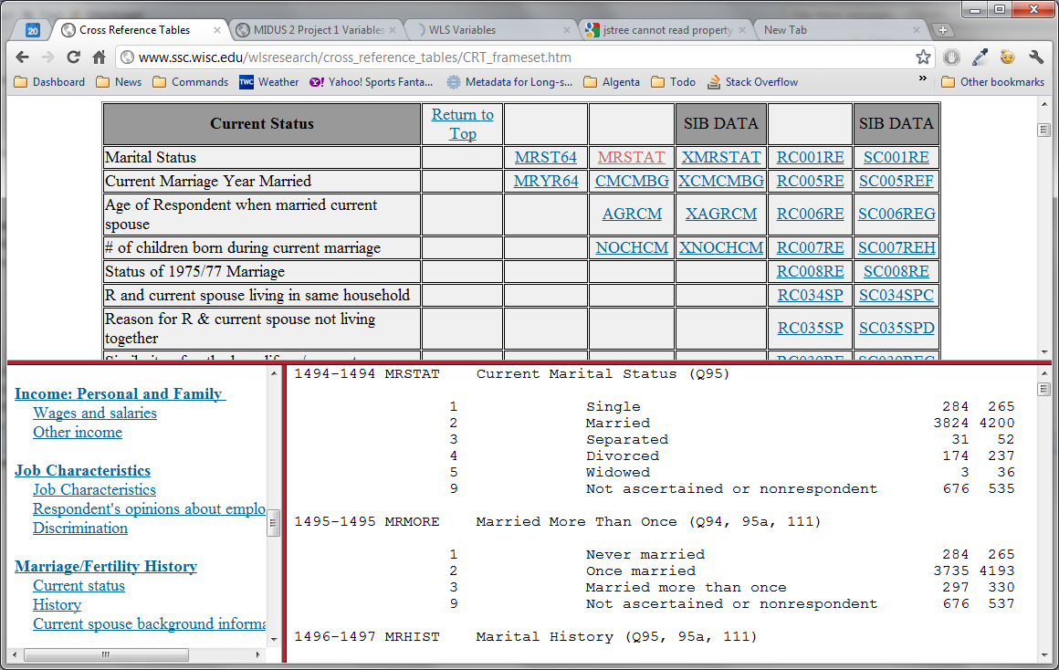
Studies
Concepts
Variables
Concepts
Codes
Categories
Summary
Statistics
Physical
Location

Slide 9
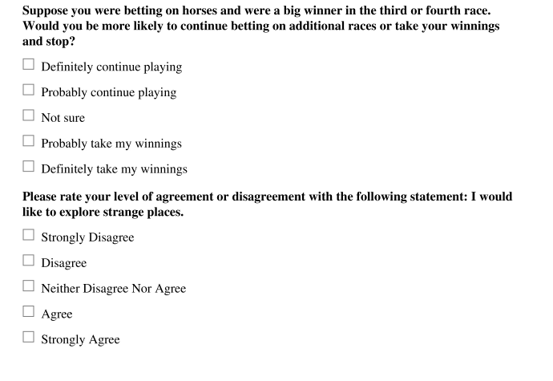
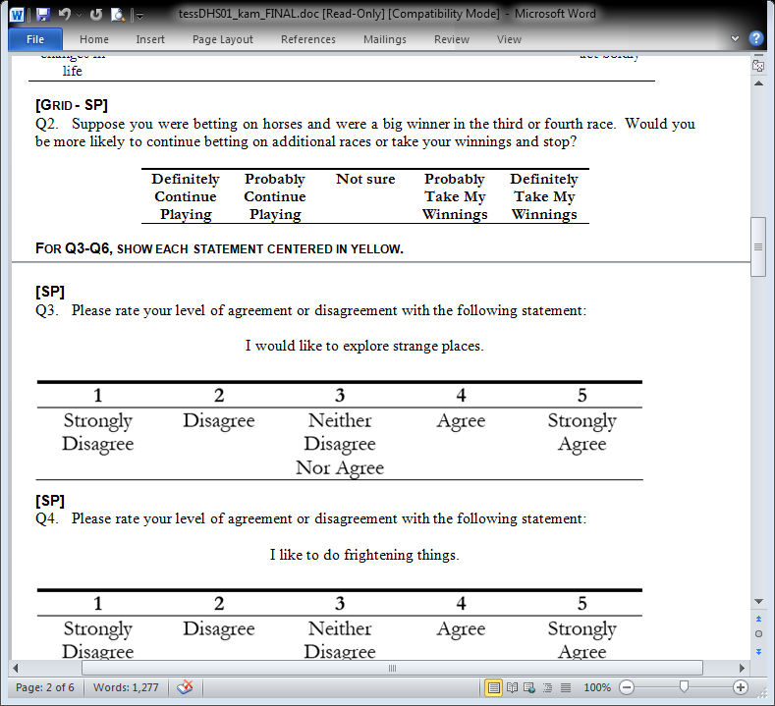
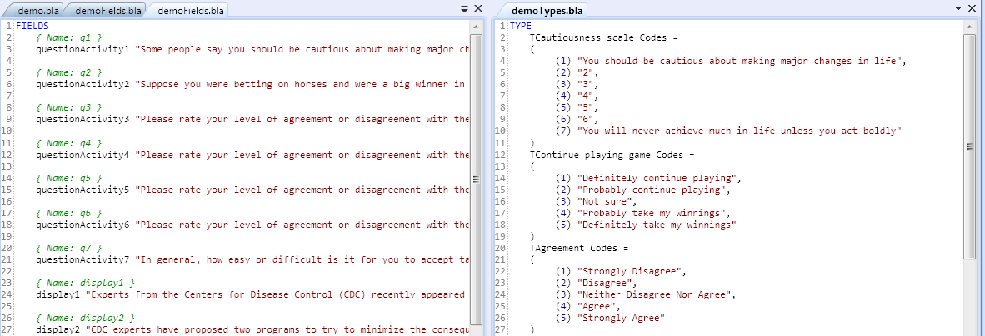
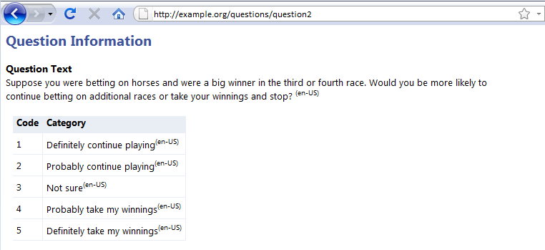
Less Redundant Work
Notes:
This looks like a paper form I guess. But if we look a little closer it’s made by a researcher who’s specifying a few things for the people who are going to the programming for the instrument.
This is a pretty typical way to specify a questionnaire design, in Word format
The issue with this is that:
You have the researcher writing the question,
a programmer retyping the question in a special syntax,
and a designer who might turn it into a paper questionnaire. in a nice-looking format.
And then after all that, somebody might go back and document the questions that were asked so you can put it up on the web. Or PDF or whatever.
How many times was the same question text typed in? Or maybe copied and pasted.
Besides the manual work, what if something changes? You need to be sure to find each place it was used and correct it there.
For a short study this might not be a big deal. But for a large, possibly longitudinal study with 100s or 1000s or 10,000s of questions and variables,
this can represent months or years of effort.
By defining the metadata first and using that to drive the creation of CAI source code, paper questionnaires, and documentation for the web and for paper,
we can save a lot of effort and eliminate lots of opportunities for mistakes

Slide 10


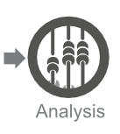
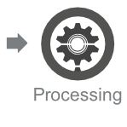
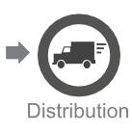

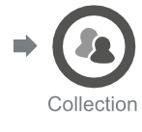

The Data Lifecycle
Documentation
Lost
Notes:
Why do it? Let’s take a look at the data lifecycle and look at the areas where you typically have documentation and where you don’t.
(Go through it)
What parts of this are generally documented? Basically, these are the big parts…
There’s a lot of other stuff going on here.
Often times, all the metadata that’s being created during the conceptual, data collection, and data processing stages is just lost. It’s not captured.
The reason for doing a metadata first approach, is that it let’s us capture all that documentation up front.

Slide 11
Better, Easier Documentation
Documentation is often a lower priority than data processing and analysis
Make documentation a byproduct of the design and collection process
The information is most accurate at this point
Notes:
Besides saving the effort, I think it can create better documentation.
When you get to the processing and analysis stages of a project, documentation is often a lower priority than the processing and analysis itself.
That may depend on the staffing levels your organization have
If you can make the documentation a byproduct of the design and collection process, you’re going to be sure it gets done, you’re not going to have to do the extra work.
Another thing that makes the documentation better is that, if it’s created at the point that the questions or other metadata are created, that’s the point when it’s most accurate.
You’re not doing it after the fact, maybe months after a researcher created a question you’re not having a grad student or an undergrad go back, draw a flowchart and comment on the purpose of a question, because it’s already done.

Slide 12
eXtensible Markup Language (XML)
XML represents information
XML is machine readable
Notes:
- XML is a machine readable format for representing information.
- That’s all it is. XML doesn’t do anything. It’s just what you see there.
- It just represents information.
- You make up your own tags. Which means you can use it to represent any kind of information you like.

Slide 13
XML Elements
<Book>
<Title>
The Hitchhiker's Guide to the Galaxy
</Title>
<Author>
Douglas Adams
</Author>
<Year>
1979
</Year>
</Book>

Slide 14
XML Attributes
<Book language=“English”>
<Title>
The Hitchhiker's Guide to the Galaxy
</Title>
<Author>
Douglas Adams
</Author>
<Year>
1979
</Year>
</Book>
Notes:
An attribute is just a simple, quoted value.
- Attributes can't contain complex information.
- But other than that, it doesn't really matter which you use. It's just a preference.

Slide 15
Conflicting Tag Names
<MyData>
<Table>
<Legs>4</Legs>
<Length units="feet">5</Length>
<Width units="feet">3</Width>
</Table>
<Table>
<Rows>4</Rows>
<Columns>3</Columns>
</Table>
</MyData>
Notes:
- If different people use the same tag name to mean different things, there can be a conflict
- A namespace makes it clear who made up which tag name.

Slide 16
<MyData
xmlns:kitchen=“http://www.example.org/kitchen”
xmlns:data=“http://www.example.org/data”>
<kitchen:Table>
<Legs>4</Legs>
<Length units="feet">5</Length>
<Width units="feet">3</Width>
</kitchen:Table>
<data:Table>
<Rows>4</Rows>
<Columns>3</Columns>
</data:Table>
</MyData>
<MyData
xmlns:kitchen=“http://www.example.org/kitchen”
xmlns:data=“http://www.example.org/data”>

Slide 17
DDI and XML
<DDIInstance>
<StudyUnit> ... </StudyUnit>
<ResourcePackage>
<QuestionScheme />
<VariableScheme />
<ConceptScheme />
<PhysicalInstance />
</ResourcePackage>
</DDIInstance>
Notes:
- DDI is just a big collection of tags that represent things important to statistical data researchers
- An XML document can be validated against the DDI specification to see if it uses the appropriate tags

Slide 18
DDI and XML
<DDIInstance>
<StudyUnit> ... </StudyUnit>
<ResourcePackage>
<QuestionScheme />
<VariableScheme />
<ConceptScheme />
<PhysicalInstance />
</ResourcePackage>
</DDIInstance>
Notes:
- DDI is just a big collection of tags that represent things important to statistical data researchers
- An XML document can be validated against the DDI specification to see if it uses the appropriate tags

Slide 19
DDI Walkthrough
Notes:
- Show an overview of the sample study
- Show the URL of the Web tool

Slide 20
Universes
People
People attending EDDI

Slide 21
A Universe in XML
<c:Universe id=“universe1">
<r:Label xml:lang="en">EDDI Participants</r:Label>
<c:HumanReadable xml:lang="en"> People attending the EDDI 2011
conference in Gothenburg.
</c:HumanReadable>
</c:Universe>

Slide 22
A Universe in XML
<c:Universe id=“universe1">
<r:Label xml:lang="en">EDDI Participants</r:Label>
<c:HumanReadable xml:lang="en"> People attending the EDDI 2011
conference in Gothenburg.
</c:HumanReadable>
</c:Universe>

Slide 23
Using the DDI Workshop Helper

Slide 24
DDI Workshop Helper
http://ddiworkshop.thatip.net/
Login: your email address
Password: eddi2011

Slide 25
Concepts
A concept defines something that may be measured
Age
Gender
Employment status

Slide 26
A Concept in DDI
<c:Concept id="concept1" version="1.0.0">
<c:ConceptName xml:lang="en">Hitchhiking</c:ConceptName>
<r:Description xml:lang="en">
Hitchhiking is a means of transportation that is
gained by asking people, usually strangers, for a
ride in their automobile or other road vehicle </r:Description>
</c:Concept>

Slide 27
Where did it go?
<ddi:DDIInstance>
<g:ResourcePackage>
<c:ConceptScheme>
<c:Concept id="concept1">...</c:Concept>
</c:ConceptScheme>
</g:ResourcePackage>
</ddi:DDIInstance>
Notes:
A Concept element is nested under a ConceptScheme
Which is nested under a ResourcePackage
Which is nested under a DDIInstance

Slide 28
Where did it go?
<ddi:DDIInstance>
<g:ResourcePackage>
<c:ConceptScheme>
<c:Concept id="concept1">...</c:Concept>
</c:ConceptScheme>
</g:ResourcePackage>
</ddi:DDIInstance>
Notes:
A Concept element is nested under a ConceptScheme
Which is nested under a ResourcePackage
Which is nested under a DDIInstance

Slide 29
Identification
<c:ConceptScheme
id="scheme1"
version="1.0.0"
agency="example.org">
<c:Concept id="c1">...</c:Concept> <c:Concept id="c2">...</c:Concept> <c:Concept id="c3">...</c:Concept>
</c:ConceptScheme>
Notes:
An agency identifies the organization or person responsible for the metadata.
An identifier uniquely identifies a DDI item.
The version says what version of the item is represented.

Slide 30
Categories
Mode of Transportation
Airplane
Automobile
Boat

Slide 31
<l:CategoryScheme id="categories1" version="1.0.0" agency="example.org">
<l:CategorySchemeName xml:lang="en">
Mode of Transportation
</l:CategorySchemeName>
<l:Category id="cat1">
<r:Label xml:lang="en">Airplane</r:Label>
</l:Category>
<l:Category id="cat2">
<r:Label xml:lang="en">Automobile</r:Label>
</l:Category>
<l:Category id="cat3">
<r:Label xml:lang="en">Boat</r:Label>
</l:Category>
</l:CategoryScheme>

Slide 32
<l:CategoryScheme id="categories1" version="1.0.0" agency="example.org">
<l:CategorySchemeName xml:lang="en">
Mode of Transportation
</l:CategorySchemeName>
<l:Category id="cat1">
<r:Label xml:lang="en">Airplane</r:Label>
</l:Category>
<l:Category id="cat2">
<r:Label xml:lang="en">Automobile</r:Label>
</l:Category>
<l:Category id="cat3">
<r:Label xml:lang="en">Boat</r:Label>
</l:Category>
</l:CategoryScheme>

Slide 33
Codes
Mode of Transportation
Value | Category
1 | Airplane
2 | Automobile
3 | Boat

Slide 34
Codes
Marital Status
Value | Category
0 | Airplane
1 | Automobile
2 | Boat

Slide 35
References in DDI
Code List 1
Category List
Code List 2
Code List 3
Notes:
When something can be used in more than one place, it is better to reference it instead of repeating it.
This is the big advantage of DDI 3 over DDI 2.
This applies to Concepts, Questions, Variables, and many other elements.

Slide 36
<l:Code>
<l:CategoryReference>
<r:Scheme>
<r:ID>categories1</r:ID>
<r:IdentifyingAgency>example.org</r:IdentifyingAgency> <r:Version>1.0.0</r:Version>
</r:Scheme>
<r:ID>cat1</r:ID>
<r:IdentifyingAgency>example.org</r:IdentifyingAgency>
<r:Version>1.0.0</r:Version>
</l:CategoryReference>
<l:Value>1</l:Value>
</l:Code>

Slide 37
<l:Code>
<l:CategoryReference>
<r:Scheme>
<r:ID>categories1</r:ID>
<r:IdentifyingAgency>example.org</r:IdentifyingAgency> <r:Version>1.0.0</r:Version>
</r:Scheme>
<r:ID>cat1</r:ID>
<r:IdentifyingAgency>example.org</r:IdentifyingAgency>
<r:Version>1.0.0</r:Version>
</l:CategoryReference>
<l:Value>1</l:Value>
</l:Code>

Slide 38
<l:CodeScheme
id="codeList1"
version="1.0.0"
agency="example.org">
<l:CodeSchemeName xml:lang="en-US">
Transportation Codes
</l:CodeSchemeName>
<l:Code>...</l:Code>
<l:Code>...</l:Code>
<l:Code>...</l:Code>
</l:CodeScheme>

Slide 39
<l:CodeScheme
id="codeList1"
version="1.0.0"
agency="example.org">
<l:CodeSchemeName xml:lang="en-US">
Transportation Codes
</l:CodeSchemeName>
<l:Code>...</l:Code>
<l:Code>...</l:Code>
<l:Code>...</l:Code>
</l:CodeScheme>

Slide 40
Questions
What is your name?
How did you get to Gothenburg?

Slide 41
A Question in DDI
<d:Questiontem id="q1" version="1.0.0">
<d:QuestionItemName xml:lang="en">name</d:QuestionItemName>
<d:QuestionText xml:lang="en">
<d:LiteralText>
<d:Text>What is your name?</d:Text>
</d:LiteralText>
</d:QuestionText>
<d:TextDomain minLength="1"></d:TextDomain>
</d:QuestionItem>

Slide 42
A Question in DDI
<d:Questiontem id="q1" version="1.0.0">
<d:QuestionItemName xml:lang="en">name</d:QuestionItemName>
<d:QuestionText xml:lang="en">
<d:LiteralText>
<d:Text>What is your name?</d:Text>
</d:LiteralText>
</d:QuestionText>
<d:TextDomain minLength="1"></d:TextDomain>
</d:QuestionItem>

Slide 43
Other Response Types
Text
Numeric
DateTime
Category
Code
Geographic

Slide 44
Question with a Code List
<d:Questiontem id="q1" version="1.0.0">
<d:QuestionItemName xml:lang="en">transport</d:QuestionItemName>
<d:QuestionText xml:lang="en">
<d:LiteralText>
<d:Text>How did you get to Gothenburg?</d:Text>
</d:LiteralText>
</d:QuestionText>
<d:CodeDomain>
<r:CodeSchemeReference>
<r:ID>codeList1</r:ID>
<r:IdentifyingAgency>example.org</r:IdentifyingAgency>
<r:Version>1.0.0</r:Version>
</r:CodeSchemeReference>
</d:CodeDomain>
</d:QuestionItem>

Slide 45
Variables
Name
Mode of Transportation

Slide 46
A Variable in DDI
<l:Variable id="var1" version="1.0.0">
<l:VariableName xml:lang="en">name</l:VariableName>
<r:Label xml:lang="en">The person's name</r:Label>
<l:Representation>
<l:TextRepresentation />
</l:Representation>
</l:Variable>

Slide 47
A Variable in DDI
<l:Variable id="var1" version="1.0.0">
<l:VariableName xml:lang="en">name</l:VariableName>
<r:Label xml:lang="en">The person's name</r:Label>
<l:Representation>
<l:TextRepresentation />
</l:Representation>
</l:Variable>

Slide 48
And Then What?

Slide 49
Studies
Study-level Information
Citation
Abstract, Purpose
Links to related materials
Study Content
Survey Instruments
Datasets

Slide 50
Publishing DDI
Notes:
Just like XML, DDI itself doesn’t actually do anything. It only represents information.
But you can write tools that read that information and publish it in useful formats.

Slide 51
Where to Learn More
The DDI Web Site
DDI Documentation
Talk to Me

Slide 52

Thank you
 | Instructor | Jeremy Iverson
 | Email | jeremy@colectica.com
 | Web | colectica.com
 | Blog | blogs.colectica.com
 | Twitter | @Colectica

